Slide 1
Performance Analysis of Joint Precoding and MUD
Techniques in Multibeam Satellite Systems
2016 IEEE Global Communications Conference (GLOBECOM)
Miguel A´ ngel Va´zquez★, Ma`rius Caus★, Ana Pe´rez-Neira★†
Centre Tecnol`ogic de Telecomunicacions de Catalunya (CTTC)
† Dept. of Signal Theory and Communications Universitat Polit`ecnica de Catalunya
Notes:
這篇論文是multibeam satellite system在使用joint precoding 以及MUD的分析

Slide 2
Agenda
Introduction
System Model
PRECODING DESIGNS
CAPACITY ANALYSIS
NUMERICAL RESULTS

Slide 3
INTRODUCTION
Broadband ubiquitous connectivity is one of the key requirements of the fifth generation (5G) communications. Indeed, providing a large data rate (50 Mbit/s - 1 Gbit/s) everywhere and anytime is a very challenging feature. Under this context and considering the elevated capital expenditures for deploying backhaul networks in low populated areas, the use of the satellite component is becoming attractive as an essential backhaul element for 5G communications.
Both academia and industry are investigating novel approaches to conceive satellite systems able to attend near a Terabit per second forward link capacity in order to serve a huge number of simultaneous users. As a matter of fact, this can only be done if the different beams that provide connectivity to the user terminals share all the available bandwidth.
This aggressive frequency reuse scheme leads to a large increase of the inter-beam interference, making interference mitigation (IM) techniques mandatory.
Notes:
ubiquitous connectivity (中文翻作”無所不在的連結”) 是5G通訊很重要的一個需求，隨時隨地提供large data rate (50Mbit/s- 1 G bits/s)在未來是一個很具有挑戰的特點。在此背景下，並考慮到在人口稠密地區部署backhaul networks的資本支出增加的情況下，使用5G衛星變得有吸引力。學術界和工業界都在研究新穎的方法來構想能夠以每秒Terabit的forward link capacity的衛星系統，以便同時為大量用戶提供服務。 實際上，只有在提供到用戶的不同beam共享所有可用頻寬的情況下，也就是frequency reuse，才能做到這一點。這種積極的frequency reuse方式導致波束間干擾的大量增加，從而使interference mitigation（IM）技術成為必要措施。

Slide 4
INTRODUCTION
Inter-beam interference in the forward link can be mitigated either at the receiver or at the transmitter side. While receiver based (multiuser detection ) IM increases the complexity
and cost of the user terminal, trasmitter based (precoding) IM assumes that the receiver performs single user detection leading to substantial reduction of the receiver complexity
However, precoding needs to waste communication resources for feeding back the channel state information to the gateway. In addition, even though the transmitter has an accurate version of the channel matrix, the achievable rates are reduced due to multicast transmission of general satellite standards [4] and other impairments
Notes:
beam之間的干擾 可以在receiver端 或者是在trasmitter端來減少，Receiver based的IM也就是multiuser detection,會增加用戶設備的複雜性與成本，但基於 transmitter based的IM(就是做precoding), 可以大大減少recevier的複雜性。
但是precoding需要浪費通道資源將通道狀況回傳給gateway，並且就算transmitter有正確的通道狀況，由於衛星標準的多傳播以及其他損失，真正的data rate也會有所損失。

Slide 5
As a general statement, electing either to perform IM at the receiver or at the transmitter requires a deep cost-performance analysis considering the peculiarities of a certain coverage area. However, for the multiuser detection (MUD) case it is evident that the receiver cannot detect more than 2 signals simultaneously due to the exponential increase of the complexity.
If more simultaneous two sources are to be detected, additional diversity such as spatial or code ones should be incorporated; thus, allowing an interference cancellation stage previous to the MUD. Consequently, the receiver based IM approach can only get rid of the largest interference signal, leading to not-so-large signal-to-noise-plus-interference ratio (SINR). This limits the frequency reuse among beams and in general it is only considered a frequency reuse factor of 2 [6], [7] ; thus, offering a limited achievable system throughput.
Notes:
通常，選擇在接收器處還是在發送器處執行IM需要考慮特定覆蓋區域的特殊性，進行深入的性價比分析。 但是，對於多用戶檢測（MUD）情況，很明顯，由於復雜度的指數增加，接收器無法同時檢測到兩個以上的信號。若要檢測兩個以上的信號，則會合併其他訊號，因此receiver based 的IM 只能消除最大的干擾訊號，導致SINR不太大，這會限制beams之間的frequency reuse，限制了系統的throughput。

Slide 6
Furthermore, precoding suffers from additional limitations. Indeed, one of the main challenges is the feeder link excessive traffic requirements since it has to transmit all the precoded data from the gateway to the satellite payload. Even though this link is placed at the Q/V band where a large bandwidth is available, the use of multiple gateways is required [8]. Since the data is precoded in isolated geographic areas, the precoding technique shall be reconsidered [9]. Based on the results of [9], even though the gateways exchange all the channel state information, the precoding gains are limited compared to the single gateway case.
Notes:
此外，precoding還受到其他的限制，最主要的挑戰是feeder link 對於整個traffic的過量需求，因為他必須從gateway傳輸所有precoding後的資料到satellite payload， 就算是使用Q/V band，也需要多個gateway，並且因為不同地理位置的gateway，所以precoding的方法也要考慮，就算互相交換了所有通道狀況，彼此間也會受到影響，效果也會受到限制。

Slide 7
In light of the above discussion, this paper investigates how to improve the current precoding limitations [4] by means of considering that the receivers are able to perform MUD. In contrast to the case where single user detection is considered, the user terminal can increase its achievable rate by decoding the signals from its neighbouring beams. In this work, a preliminary evaluation in terms of capacity is presented. To simplify the analysis, a unicast satellite transmission (one user served per frame) is considered as well as perfect channel state information and single gateway architecture.
In contrast to the aforementioned works, this paper conducts a capacity analysis when different decoding strategies and precoding techniques are applied. The numerical results are performed with a real multibeam radiation pattern, making out validations close to the real performance. As it is expected, the use of IM at the receiver side jointly with current precoding techniques yield to a large increase of the overall throughput. The contributions of the paper are twofold. First, we evaluate different receiver strategies without the use of precoding and; posteriorly, we show how precoding increases the system achievable rate. Moreover, a novel precoding technique is first evaluated for multibeam satellite systems and it is observed that larger throughputs can be obtained compared to the current state of the art.
Notes:
鑑於以上討論，本文通過考慮能夠執行MUD的接收器來研究如何改善當前的precoding限制[4]。 與考慮單個用戶檢測的情況相比，receviers可以通過對來自其相鄰beam的信號進行解碼來提高其可達到的data rate。 在這項工作中，對容量進行了初步評估。 為了簡化分析，考慮了單播衛星傳輸（每幀一個用戶服務）以及完美的通道狀況信息和單個gateway結構。
本文在應用不同的decoding策略和precoding技術時進行容量分析。 在接收器端結合使用IM和當前的precoding技術可以大大提高整體throughput。 本文的貢獻有兩個。 首先，我們評估了不使用precoding的不同接收器策略； 在後面，我們展示了precoding如何增加系統可達到的data rate。 此外，首先針對多波束衛星系統評估了一種新穎的預編碼技術，並且發現與現有技術相比，可以獲得更大的throughput。

Slide 8
System model

Slide 9
System Model
Let us consider a multibeam satellite system where the satellite is equipped with an array fed reflector antenna with a total number of feeds equal to 𝑁. These feed signals are
combined and they generate a beam radiation pattern forming a total number of 𝐾 beams. In this work we have focused on the case where 𝐾 ≥ 𝑁.
The multibeam radiation pattern supports data multiplexing among beams leading to an efficient communication since rate allocation can be performed separately for each beam. Unfortunately, adjacent beams create multiuser interference which becomes the major bottleneck of the communication.
In case the system designer targets larger achievable throughputs, frequency reuse among beams is compulsory so as interference mitigation techniques either at the user terminals (MUD) or at the transmit side (precoding).
This paper focuses on the combination of both.
Notes:
作者考慮了一個multibeam satellite system 且satellite配有陣列饋電反射器天線， feeds數為N，這些feed signal會合併並產生一個beam radiation pattern ，Beam的總數為K。
為了解決beam之間互相干擾問題，一般來說系統設計者可以為每個波束分配不同的頻帶，從而以減少可用頻寬為代價，大大降低了乾擾，但如果系統設計人員以更大的throughput為目標，則beam之間的frequency reuse是強制性的，因此可以在用戶終端（MUD）或在發送端（預編碼）使用IM技術。
本文著重於兩者的結合。

Slide 10
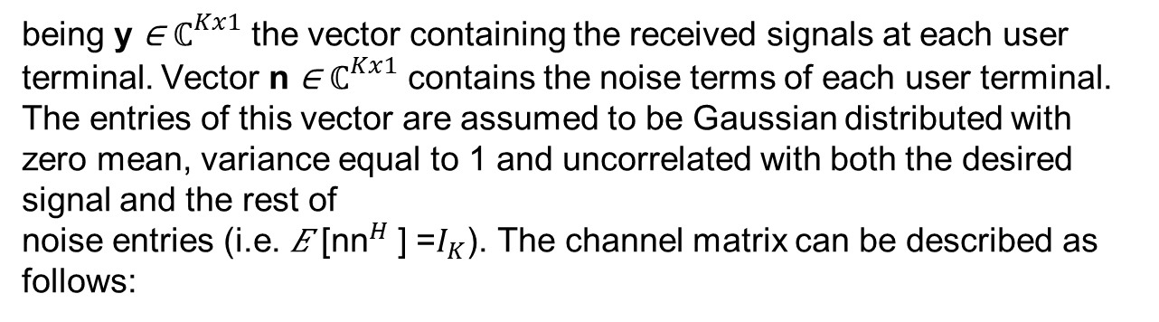
Considering that all beams radiate in the same frequency band, the receive signal can be modelled as
y = Hx + n, (1)
being y ∈ ${\text{ℂ}}^{Kx1}$ the vector containing the received signals at each user terminal. Vector n ∈ ${\text{ℂ}}^{Kx1}$ contains the noise terms of each user terminal. The entries of this vector are assumed to be Gaussian distributed with zero mean, variance equal to 1 and uncorrelated with both the desired signal and the rest of
noise entries (i.e. 𝐸 [${\text{nn}}^{H}$ ] =$I_{K}$). The channel matrix can be described as follows:
H = AG, (2)
Notes:
假設所有的beam都使用同一格頻帶，接收到德訊號可以用第一個式子表示。
Y代表的是每個user收到的訊號，n代表的是雜訊
X代表打出去的訊號，
H代表的是channel matrix， 由式子2表示
A代表大氣中的衰弱因子，G 表示剩下的 gain 與 loss factors

Slide 11
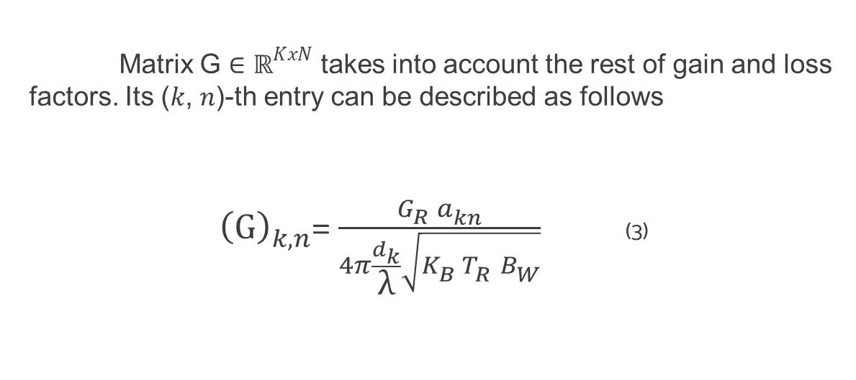
Matrix G ∈ ${\text{ℝ}}_{}^{KxN}$ takes into account the rest of gain and loss factors. Its (𝑘, 𝑛)-th entry can be described as follows
${\left(G\right)}_{k,n}^{}$= $\frac{G_{R}^{}a_{kn}^{}}{4π\frac{d_{k}}{\text{λ}}\sqrt{K_{B}^{}T_{R}^{}B_{W}^{}}}$ (3)
Notes:
G 表示剩下的 gain 與 loss factors
𝜆 is the carrier wavelength
$d﷮k$the distance between the 𝑘-th user terminal and the satellite.
$K_{B}^{}$is the Boltzmann constant,
𝐵𝑊 is the carrier bandwidth
𝑇𝑅 the receiver noise temperature
𝐺𝑅 the user terminal receive antenna gain
𝑎𝑘𝑛 refers to the gain from the 𝑛-th feed to the 𝑘-th user.

Slide 12
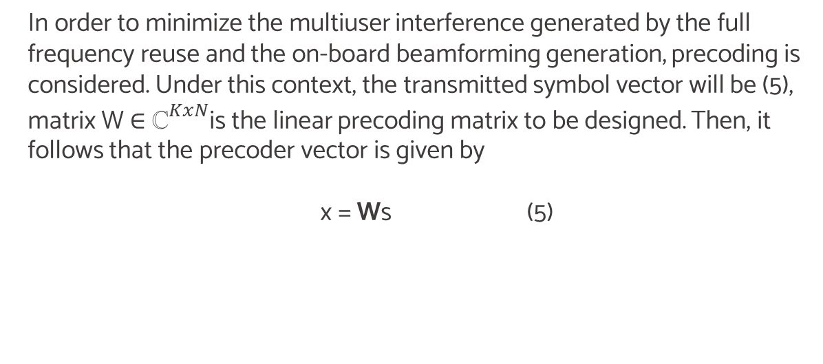
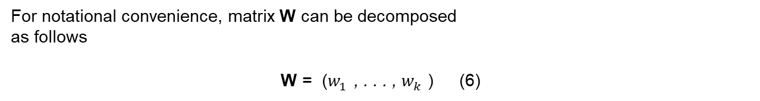
In order to minimize the multiuser interference generated by the full frequency reuse and the on-board beamforming generation, precoding is considered. Under this context, the transmitted symbol vector will be (5), matrix W ∈ ${\text{ℂ}}_{}^{KxN}$is the linear precoding matrix to be designed. Then, it follows that the precoder vector is given by
x = Ws (5)
For notational convenience, matrix W can be decomposed
as follows
W = ($w_{1}^{}$, . . . , $w_{k}^{}$) (6)
Notes:
為了最大程度地減少由full frequency reuse和beamforming產生的多用戶干擾，作者考慮precoding
第五式子代表的是transmitted symbol vector
s is a vector that contains the transmitted symbols
matrix W is the linear precoding matrix to be designed.
w is the precoding vector for the 𝑖-th user.

Slide 13

y = Hx + n (1)
H = AG (2)
${\left(G\right)}_{k,n}^{}$= $\frac{G_{R}^{}a_{kn}^{}}{4π\frac{d_{k}}{\text{λ}}\sqrt{K_{B}^{}T_{R}^{}B_{W}^{}}}$ (3)
x = Ws (5)
Channel matrix
Gain and loss factor
W = linear precoding matrix

Slide 14
Precoding Design
Notes:
Precoding用在減輕波束間干擾，同時保持所需的信噪比（SNR）高。

Slide 15
Attending to the performance computational complexity trade-off the adequate precoding schemes are zero-forcing (ZF) and minimum mean square error (MMSE) under a simple scaling factor power allocation.
ZF
MMSE
零抑制等化器:
ZF等化器候確實可以將無線通道雜訊 消除，但是缺點卻放大了AWGN雜訊，所以說ZF等化器 比較適合用再信號雜訊比(Signal to Noise Ratio ,SNR)比較 大的時後
最小均方等化器:
MMSE等化器則是在則是使設計估測通道信號及實際信號的均方誤差為最小，雖然不能完全消除ISI但不會造成雜訊的放大
Notes:
考慮到性能計算複雜性的折衷，適當的預編碼方案零抑制等化器（ZF）和最小均方誤差（MMSE）。

Slide 16

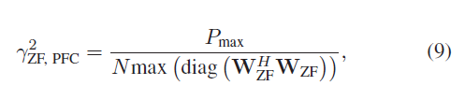
if the payload is equipped with flexible multiport amplifiers where the total power is shared among them,
if the aforementioned power sharing among feeds does not exist and each feed
Notes:
𝛾ZF controls the transmit power
如果有效載荷配備了靈活的多端口放大器，其中總功率由它們共享
SPC refers to sum-power constraints
𝑃max is the maximum transmit power.
如果不存在上述提要之間的功率共享，並且每個提要都有其唯一的功率預算， 則會變成如下
PFC stands for per-feed power constraints
每個feed的power constraint is Pmax/N.

Slide 17
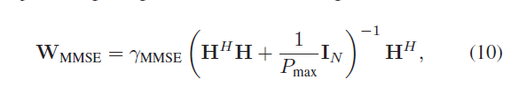
While ZF technique nulls the inter-beam interference if 𝑁 ≥ 𝐾, MMSE design leaves certain interference with the aim of increasing the SNR of the desired signal. Mathematically, the precoding design takes the form of a regularized ZF scheme
Notes:
ZF 雖然可以完全消除inter beams的干擾，但會產生高斯白雜訊，降低SNR
MMSE設計則留有一定的干擾，目的是提高所需信號的SNR。

Slide 18
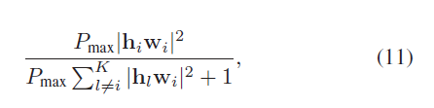
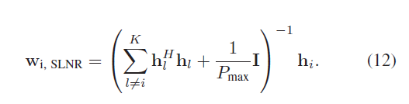
In this paper we will evaluate an additional precoding design based on the signal-to-leakage-interference optimization.
As mentioned earlier, apart from the ZF technique, both MMSE and SLNR do not completely null the interference power levels, in order to increase the desired user SNR. The next section describes how these remaining interfering signals can be used for increasing the achievable rates by means of different decoding strategies.
Notes:
在本篇論文也額外評估基於信號洩漏干擾優化的預編碼設計。一開始提出是為了針對MIMO，這種precoding方法可以依序獲得最佳的precoding vector
除了ZF之外，為了增加SNR，MMSE和SLNR都沒有完全消除乾擾。 下一節將介紹如何通過不同的decoding scheme將這些剩餘的干擾信號用於提高可達到的速率。

Slide 19
CAPACITY
ANALYSIS
Notes:
Precoding用在減輕波束間干擾，同時保持所需的信噪比（SNR）高。

Slide 20
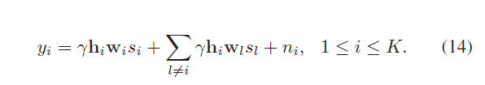
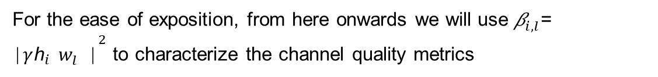
When the transmitted data is linearly precoded, the signal received by the ith user can be expressed as
Building upon (14), the rest of the section is devoted to provide the rate bounds for different decoding strategies
For the ease of exposition, from here onwards we will use ${\text{β}}_{i,l}^{}$= ${\text{∣}\text{γ}{\text{h}}_{i}^{}w_{l}^{}\text{∣}}^{2}$ to characterize the channel quality metrics
Notes:
當對發送的數據進行linear precoding時，第i個用戶接收的信號可以表示為下
令𝛾表示控制發射功率的precoding正規化因子。
在（14）的基礎上，本節的其餘部分專門為不同的解碼策略提供速率範圍
會$用{\text{β}}_{i,l}^{}來代表$channel quality metrics

Slide 21
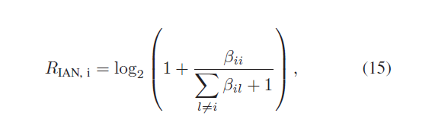
A. Interference as noise (IAN)
Resorting to this receiver structure, the interfering signals that come from adjacent beams are treated as noise. Under the Gaussian signaling assumption, the maximum achievable rate becomes
Notes:
依靠這種接收器結構，來自相鄰波束的干擾信號被視為噪聲。 在Gaussian signaling假設下，最大可實現速率變為:

Slide 22
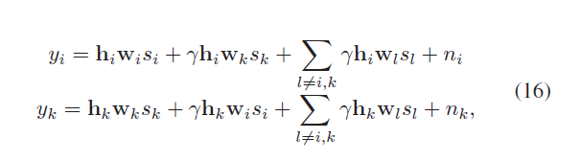
B. Simultaneous Non-unique Decoding (SND)
The beauty of single user detector schemes stems from the fact that the implementation of the receiver is very simple. That is because the streams can be independently decoded and, thus, the complexity does not grow with the number of beams. However, if the magnitude of the unwanted and the desired signals are similar, the system is limited by the interference and, consequently, the capacity is significantly degraded. To overcome this issue, it is necessary to take into account the structure of the interference instead of treating it as noise.
Bearing this in mind, we propose to leverage on the interference by grouping the beams in pairs, so that the number of disjoint sets is equal to 𝐾/2 . In this case, the system of equations that characterize a given pair of beams is given by
Notes:
單用戶檢測器方案的優點在於，接收器的實現非常簡單。這是因為stream可以被獨立地解碼，因此，複雜度不會隨著beam的數量而增加。但是，如果非所需信號和所需信號的大小相似，則系統會受到干擾的限制，因此容量會大大降低。 為了克服這個問題，有必要考慮干擾的結構，而不是將其視為噪聲。
作者建議將beam成對分組 使不交集的數量為k/2 可以表示為下面的樣子
通過觀察（16），可以推斷出我們應該選擇相互干擾最大的最近beam。
然後，剩下干擾會被最小化

Slide 23
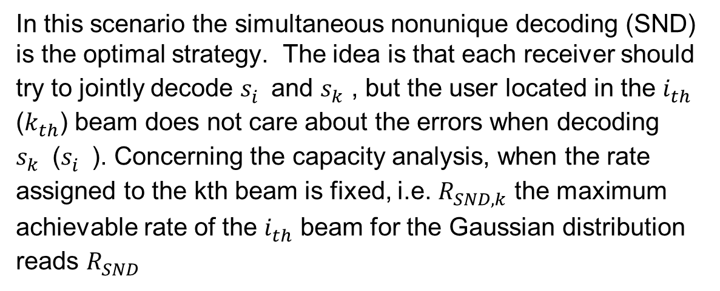
In this scenario the simultaneous nonunique decoding (SND) is the optimal strategy. The idea is that each receiver should try to jointly decode $s_{i}^{}$and $s_{k}^{}$, but the user located in the $i_{th}^{}$ ($k_{th}^{}$) beam does not care about the errors when decoding $s_{k}^{}$($s_{i}^{}$). Concerning the capacity analysis, when the rate assigned to the kth beam is fixed, i.e. $R_{SND,k}^{}$ the maximum achievable rate of the $i_{th}^{}$ beam for the Gaussian distribution reads $R_{SND}^{}$
Notes:
在這個場景下，SND被認為是最好的decoding scheme
每個接收者嘗試從其預期的發送者中恢復唯一的symbol，並從乾擾的發送者中恢復symbol，但不會在意干擾這邊的錯誤

Slide 24
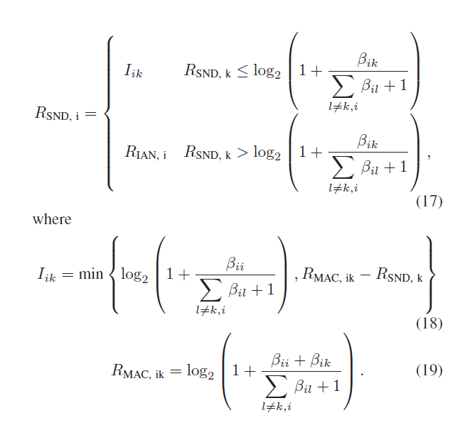
Concerning the capacity analysis, when the rate assigned to the kth beam is fixed, i.e. 𝑅SND, k, the maximum achievable rate of the ith beam for the Gaussian distribution reads
Notes:
當分配給第k個beam的data rate固定時，即𝑅SND，k時，第i個beam對於高斯分佈的最大可達到速率為

Slide 25
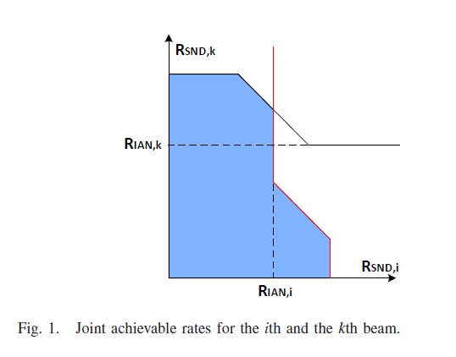
It is particularly noteworthy that the rate region that is jointly achievable in the ith and kth beams is the intersection of (17) and (20).
In this case, the highest sum-rate is determined by one of the corner points, which are achievable by a SIC receiver.
Notes:
在這種情況下，最高的sum-rate由可達到的拐角點之一確定。

Slide 26
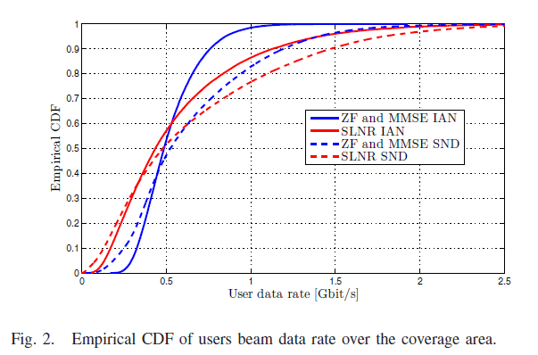
Figure 2 presents the empirical cumulative distributed function (CDF) of the data rate whenever the receivers implement SND or IAN with different precoding techniques.
Notes:
圖給出了每當接收器使用不同的預編碼技術實現SND或IAN時的數據速率的經驗累積分佈函數（CDF）。
SND策略能夠以最高的概率提供最高的data rate，明顯優於IAN方法。

Slide 27
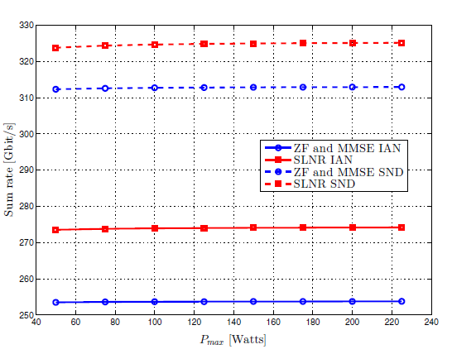
In this figure we can observe that SND receiver technique increases the sum-rate in all precoding schemes. Precisely, it increases the system capacity a factor of 23% in the MMSE and ZF case where as for the SLNR it increases the sum-rate 18%.
Notes:
在此圖中，我們可以觀察到SND接收器技術在所有預編碼方案中均提高了總速率。 準確地說，它在MMSE和ZF情況下將系統容量增加了23％，而對於SLNR，它將總和增加了18％。 並且可以看到 基於SLNR的precoding與SND 表現出最高的sum rate

Slide 28
Conclusion
This paper investigates how high performance receivers can increase the data rate of precoding techniques in multibeam satellite systems. SND is able to significantly increase the achievable rates of a simple precoding operation with IAN. In
contrast to other studies, we point out that SLNR precoding offers higher data rates compared to ZF and MMSE both under IAN and SND.
Notes:
本文研究了高性能接收機如何在多波束衛星系統中提高precoding技術的data rate。與其他研究相比，我們指出在IAN和SND下，SLNR precoding與ZF和MMSE相比提供更高的data rate。
此外，還應考慮到信道狀態信息錯誤和multicast的情況。

